Slide 1

HUM111 Pakistan Studies
Lecture 03

Slide 2
HUM 111 Pakistan Studies
Lecture 03
Historical Background of Pakistan
(Causes/ failure of the war of Independence 1857, its impact on Hindu Muslim Unity)
Dr. Sohail Ahmad

Slide 3


Historical Movement
Basis of historical movement for creation of Pakistan may be said to begin with the outbreak of the War of Independence in 1857.
The War of Independence opened on 10th May 1857 in Meerut, a remote and small city of the United Province of the subcontinent.
Though unsuccessful, It brought many changes, particularly in the political strategies of three parties:
British
Hindus
Muslims

Slide 4
Causes of the Revolt in 1857
Economic.
Administrative.
Political
Religious
Social
Military
Immediate Cause

Slide 5
Economic Causes
Before the East India Company ‘s(EIC) rule, India’s agriculture Industry and trade was flourishing.
The British tried to exploit India for their economic gains and fulfill demands of their industrial revolution.
Indian exports to Britain i.e. cotton, tea, spices ended up in India as finished goods or were further exported to other countries.
After gaining right to collect revenue in Bengal in 1765, the EIC used the money raised through revenue in Bengal for fighting wars in other parts of India
The Policies of EIC badly affected Zamindars, Talookdars, middle income groups, traders, laborers etc.

Slide 6
Administrative Causes
Inefficient and Insufficient Administrative machinery.
Annexation of Indian States as part of their expansionist policies under the Doctrine of Lapse.
All high posts; civil or military were given to Europeans rather than locals
Unjust and exploitative revenue policies.

Slide 7
Political Causes
British expansionist policies.
Order of Lord Canning to the Mughal Empror to leave Red Fort Delhi and stay at Qutab Minar .
Lord Canning order that after the demise of Bahadur Shah Zafar the Mughal rule will come to an end and all the property of the Mughal ruler will be snatched away

Slide 8
Social/ Religious Causes
Support to Christian Missionaries after 1813 was extended. They were not allowed to come to India before that year.
The Religious Disability Act announced many incentives for those Indians who would convert to Christianity .
Reforms in Hindu customs were made by law however, they were considered as distortion of the teaching of Hinduism
It was widely believed after 1813 that the actual mandate of EIC was to convert Indians especially Hindus to Christianity.

Slide 9
Military Causes
Great disparity in the salaries between Indian and European soldiers.
Sepoys were sent to distant-over seas- parts of the Empire, but were not given extra salaries.
Indian sepoys were treated with contempt by their English officers.
Indian sepoys were refused promotion in services as like their English counterparts. Out of such discontent the Indian sepoys led to mutiny.
General Service Enlistment Act 1856 by Lord Canning for the soldiers from Bengal to be recruited and posted whereever the Empire needed them, was greatly resented by the Hindus, as traveling by sea for some Hindus meant leaving the fold of Hinduism

Slide 10
Immediate Cause
Enfield rifles were introduced in the military.
The bullets of these rifles were covered by papers with grease like substance. The sepoys were to cut the cover with teeth before using it.
Rumor spread that the grease substance is made up of the fat of pigs and cows.
Both Muslims and Hindu sepoys refused to cut the cover. They protested against the introduction of this new munition and were arrested. It ultimately ignited the fire of mutiny all over India
The Mutiny was suppressed and the British government officially took over the rule of India from EIC.

Slide 11
Causes of Failure of the Revolt 1/2
Lack of definite aim by the Indians.
Every group and faction fought for personal reasons without a central Indian command.
Some had problem with job insecurity, some had problem with high taxes, while others were concerned with preserving their rule in their states etc.
Lack of Unity.
The revolt was not pre-decided. It could not start at one time in the whole of India therefore, EIC effectively crushed it.

Slide 12
Causes of Failure of the Revolt 2/2
Lack of public support: Educated groups (mainly converts to Christianity), many traders, and lots of peasants did not participate in it because they were blossoming in the rule of EIC.
Lack of national spirit. Lacknow, Jhansi and Bihar just revolted to safeguard their rulers’ narrow interests rather than safeguarding the larger interest of India
No efficient war tactics: The Mughal ruler and other local rulers had quite weak armies which had no match for the English officers and their war tactics.
The efficient English officials were able to suppress mutiny in 1857

Slide 13
Nature of the War of Independence
It was not religious.
It was more economic and socio-cultural.
It was blamed by Hindus to be the act of Muslims alone as religious conspiracy against the British.

Slide 14
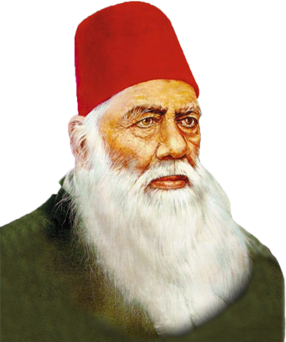
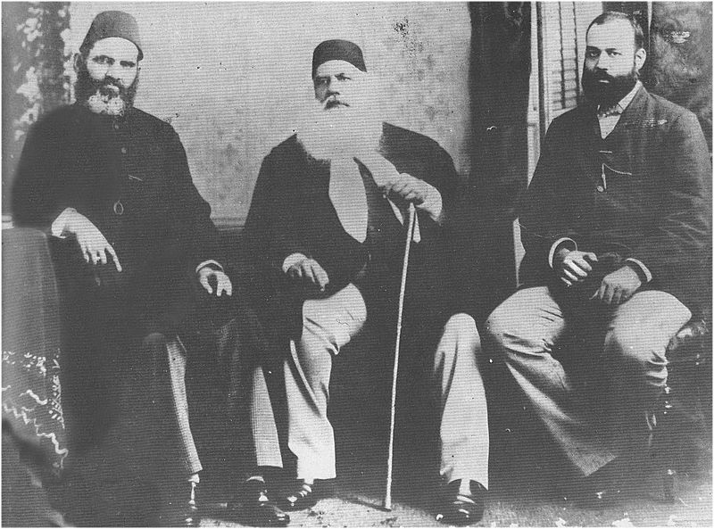
Urdu-Hindi Controversy [1/10]
Advent of Sir Syed Ahmed Khan
Language is a fundamental means of social-cultural interaction.
It may lead to disintegration in societies with cultural diversities.

Slide 15
Urdu-Hindi Controversy [2/10]
The Urdu language was born in India.
India was considered to be a golden sparrow in terms of its fertile land and man power. That is why lots of invaders came to occupy it for different purposes.
It so happened that when these different people from different regions of the world came to India, they brought with them, among other things, their language as well.
People like Arabs, Persians and Turks, etc. when mingled with the native people, they exchanged many words of their languages and thus with this mingling, a new language emerged which was termed Urdu, meaning the “language of the troops”.
Since it was formed by the invaders of the Muslim world and emerged during the rule of the Mughals in India, it was termed as the language of the Muslims and that is why initially it was called “Musalmani”.

Slide 16
Urdu-Hindi Controversy [3/10]
However, there were not only Muslims that spoke or used Urdu but all the communities in India joined hands for the promulgation and development of that new language.
It was not only used as an everyday language but a large number of literary works appeared in Urdu in all the regions of the sub-continent primarily Deccan, Lucknow, Maisur, Delhi etc.
Thus, almost the whole of India contributed to the flourishing of Urdu.
In 1837, Persian was replaced by Urdu as the court and state language, no one objected to that.

Slide 17
Urdu-Hindi Controversy [4/10]
With the fall of the Mughal Empire, Hindus, however, started looking at Urdu as the language of the invaders.
The British on the other hand, in their disregard for Muslims adopted the same attitude.
Thus, both intentionally started their efforts in order to get rid of the language of the Muslims.
In this regard names of Raja Ram Mohan Roy, Raja Shiv Parshad, Lakshman Singh, Haresh Chandra and Binkam Chatterji, etc., among many others are well known.

Slide 18
Urdu-Hindi Controversy [5/10]
The first effort was made at the start of the nineteenth century when a new language was formed with the name Hindi in which words of pure Arabic, Persian and Turkish were removed and replaced by Sanskrit words.
In that regard in 1809, a Hindu wrote a novel in that very Hindi with the title “Prem Sagar” but since it was not a full fledged effort, soon that language went into oblivion.
However, after the War of Independence 1857 when the British Crown’s wrath fell upon the Muslims, the Hindus considered it to be a ripe moment to get rid of Urdu and replace it with their own language – Hindi.

Slide 19
Urdu-Hindi Controversy [6/10]
The combined organized effort started in the second half of the nineteenth century. In 1867, the Hindus of Banaras presented a request to their government regarding the replacement of Urdu with Hindi and its Persian script with that of Devnagri script.
Sir Syed Ahmed Khan at that demand remarked that when even the language of a nation is not safe at the hands of other nations in a region, it would be unwise to continue living with them.
Sir Syed, who was in fact a great advocate of Hindu-Muslim unity prior to that incident, started focusing on the cause of Muslims alone.
His Scientific Society Gazette presented articles on the importance of Urdu.
Similarly, some Muslim newspapers like Noor-ul-Absar and Banaras Gazette also took the responsibility to safeguard their language.

Slide 20
Urdu-Hindi Controversy [7/10]
The anti-Urdu process continued when, in 1871, the Governor of Bengal, G. Cambell, banned Urdu in the province at all levels, courts, administration and even schools.
This boosted the Hindus in other regions like NWFP, Punjab, Behar, Sindh, Oudh, etc. to counter Urdu there.
Meetings were held of the Hindus in which thousands of them signed memorials supporting the cause of elimination of Urdu.

Slide 21
Urdu-Hindi Controversy [8/10]
The circumstances became even more hard for the Muslims and their language when Anthony MacDonnel became the governor of UP in 1900. He was a pro-Hindu and thus anti-Muslim.
He dismissed Urdu as the official language of UP, which was in fact considered to be the home of Urdu language.
Issued orders and declared Hindi the official language of the province.
Sir Syed’s successors at Aligarh, mainly Nawab Mohsin-ul-Mulk, the Secretary of the Aligarh Trust, took action against MacDonnel’s act.
He called for a popular gathering of the supporters of Urdu at Aligarh and openly condemned governor’s work.

Slide 22
Urdu-Hindi Controversy [9/10]
He also founded Urdu Defense Association and it was decided that the association would take actions against the doings of the governor.
The result of this Muslim response was that Urdu too- along with Hindi- was declared the official language of the province.
But Mohsin-ul-Mulk was not satisfied with this outcome and continued his struggle.
When UP got rid of MacDonnel, he founded another association called Anjuman-e-Tarraqi-e-Urdu to counter all future attempts of the Hindus and the English against Urdu.

Slide 23
Urdu-Hindi Controversy [10/10]
This love and passion for Urdu by the Muslims of India inclined the founders of Pakistan to adopt it as the national language of the new born country. They believed that it was a sign of the Muslim unity, the representation of Muslims as an independent nation, among millions of people of India.

Slide 24
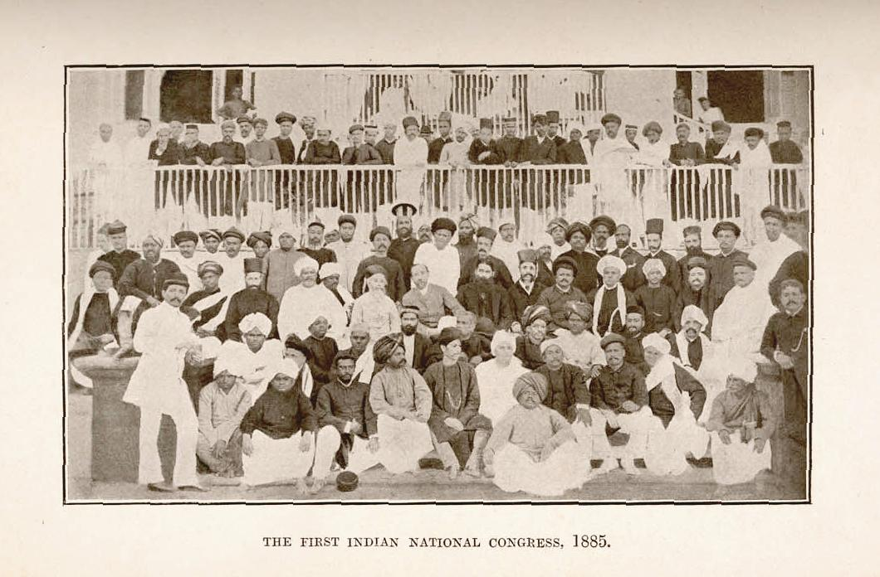
Formation of Indian National Congress
Indian National Congress was founded on December 28, 1885.
Womesh Chunder Bonnerjee was selected as the leader of the congress.

Slide 25
Muslims and the Congress
Objectives of congress
The fusion into one national whole of all the different, and till now discordant (بے آہنگ,بے سُرا), elements that constitute the population of India.
The gradual regeneration of Indians along all lines, mental, moral, social and political.
The consolidation of the union between England and India, by securing the modification of such of its condition as may be unjust or injurious to the latter country.

Slide 26
A theory about Creation of Congress
Congress was founded by an Englishman A.O. Hume, a retired government official. The blessings of Lord Dufferin, the Governor-General of India was there.
When Hume took the scheme to the Governor-General, the latter amended it and gave his blessing on the condition that:
“His name in this connection with the scheme of the congress should not be divulged so long as he remained in the country and his condition was faithfully maintained and none but the men consulted by Mr. Hume knew any thing about the matter.”
~ W.C. Bonnerjee, Indan Politics (London: 1898), P.vii

Slide 27
Sir Syed About the Congress
He asked the Muslims not to join congress.
The advice was followed by a vast majority of people.
He was of the opinion that if he was told that even the Viceroy, the Secretary of State and the whole House of Commons had openly supported Congress, he would still remain firmly opposed to it.
“It is my deliberate belief that should the resolution of the native congress be carried into effect, it would be impossible for the British Government to preserve peace, or control in any degree the violence and civil wars which would ensue.”
~ Quoted in the The Times , 12 November, 1888

Slide 28
Contemporary Muslim Press in India about Congress
It was full of criticism of the congress.
Mohammadan Observer, The Victoria Paper, The Muslim Herald, the Rafiq-i-Hind and Imperial Paper spoke with one voice against the congress.

Slide 29
Muslims Organizations and Institutions about Congress
Central National Muhammadan Association, Muhammadan Literary Society of Bengal, the Anjuman-i-Islam of Madras, the Dindigal Anjuman and the Muhammadan Central Association of the Punjab asked the Muslims of Indian not to join congress as they thought it would never serve the interests of the Muslims of India.

Slide 30
Partition of Bengal
In 1905, the provinces of Bengal and Assam were reconstituted so as to form two provinces of manageable size.
Bengal: ~42 million Hindus and ~9 million Muslims
East Bengal: ~18 million Muslims and ~12 million Hindus
The scheme was sent to London in February, 1905. The Province of East Bengal and Assam officially came into being on 16 October, 1905.

Slide 31
Hindu Reaction
The whole plan was nothing but readjustment of administrative boundaries. However, the Hindus resented it.
The partition resulted in the creation of Muslim majority province.
It was distasteful to the Hindus.
Hindus regarded the partition as an attempt to strangle nationalism in Bengal, where it was more developed than elsewhere.
Agitation against the partition included mass meetings, rural unrest, and a “swadeshi” (native) movement to boycott the import of British goods.

Slide 32
Muslim Reaction
Seven days after the partition, on 22 October 1905, a large Muslim meeting at Dacca appreciated the boon conferred on the people by the change.
Two days later, another huge gathering of Muslims offered thanks to the God for the partition and declared that under the new scheme,
“…the Muslims would be spared many oppressions which they hitherto had to endure from the Hindus.”, the Hindu agitation against the partition was condemned.
~ Manchester Guardian, 23 and 27 October, 1905

Slide 33
Annulment of the Partition of Bengal
In 1911, East and West Bengal were reunited.
The aim was to combine appeasement of Bengali sentiment with administrative convenience.
This end was achieved for a time but the Bengali Muslims, having benefitted from partition, were angry and disappointed.
This resentment remained throughout the rest of the British period.
The final division of Bengal was done at the partitioning of the subcontinent in 1947, which divided Bengal into India in the West and East Pakistan (later Bangladesh) in the East. It was also accompanied by intense violence.

